Slide 1
CHIRI
FEELANCER

Slide 2
Chiri Freelancer Management System
Efficiency, Collaboration, and Growth

Slide 3
System Description
The Chiri Freelancer Management System is a multifaceted software platform designed to revolutionize freelance management. It serves as a central hub for freelancers to efficiently manage projects, clients, and financials. Key features include gig tracking, client relationship management, project bidding, financial insights, and collaborative tools. Chiri empowers freelancers to thrive in the gig economy by simplifying complex processes and enhancing their freelance experience.
The purpose of the Chiri Freelancer Management System is to empower freelancers with efficient tools and resources, streamline freelance operations, foster collaboration, and provide personalized financial insights. This project aims to simplify freelancers' lives and enhance their success in the freelance economy.

Slide 4
Functional Requirements
01
02
03
04
05
06
07
08
09
User Management
System Description
Functional Requirements
User Management
Gig Tracking
Client Management
Project Management
Project Bidding
Seller Management

Slide 5
Functional Requirements
10
11
12
13
05
Support Ticket System
Project Reports
Buyer Reports
Target Reports
Gig Tracking

Slide 6
Non-Functional Requirements
01
02
03
04
05
06
Performance
Security
Usability
Compatibility
Scalability
Reliability

Slide 7
System Architecture
The Chiri Freelancer Management System adopts a modern and scalable architecture to ensure robust performance and flexibility. It comprises three primary components:

Slide 8
System Architecture
The Chiri Freelancer Management System adopts a modern and scalable architecture to ensure robust performance and flexibility. It comprises three primary components:
Client-Side Application: The client-side application is built using modern web technologies, providing a responsive and user-friendly interface accessible from web browsers and mobile devices.
Server-Side Application: The server-side application is developed using Node.js and hosted on cloud infrastructure. It handles data processing, user authentication, and business logic.
Third-Party Integrations: Chiri seamlessly integrates with third-party services for payment processing, communication, and data analytics, ensuring a comprehensive and feature-rich ecosystem.

Slide 9
Functional Requirements

Slide 10
Functional Requirements
User Management
Chiri's User Management module enables:
User registration and profile creation.
Secure authentication and login procedures.
User role assignment (Freelancer, Client, Administrator).
User profile updates, including personal and contact information.
Password reset and recovery mechanisms for enhanced security.

Slide 11
Functional Requirements
Gig Tracking
Chiri's Gig Tracking feature allows freelancers to:
Create and manage gigs or projects.
Monitor project progress and milestones.
Track project timelines and deadlines.
Record gig-related expenses and income.
Generate reports for individual gigs.

Slide 12
Functional Requirements
Client Management
Chiri's Gig Tracking feature allows freelancers to:
Efficient client communication and interaction.
Client profile creation and management.
Client project history and interaction tracking.
Integration with project management for seamless collaboration.

Slide 13
Non-Functional Requirements
Chiri is committed to meeting the following non-functional requirements:
Performance: The system should maintain responsive performance even with a large user base and extensive data.
Security: Robust security measures should protect user data, financial transactions, and system integrity.
Usability: The user interface should be intuitive, ensuring a positive user experience.
Compatibility: Chiri should be accessible across various devices and web browsers.
Scalability: The system should easily scale to accommodate increasing user numbers and data loads.
Reliability: Chiri should be highly available and reliable, minimizing downtime.

Slide 14
User Interfaces
Chiri's user interfaces must adhere to the following non-functional requirements:
Responsiveness: The interfaces should load quickly and adapt to different screen sizes and resolutions for a seamless user experience.
Accessibility: The interfaces should comply with accessibility standards to ensure usability for all users, including those with disabilities.
Consistency: The design elements, layout, and navigation should maintain consistency throughout the platform to enhance user familiarity and usability.
Intuitiveness: User interfaces should be intuitive, requiring minimal user training and allowing users to perform tasks efficiently.
Performance: Interfaces should be optimized for speed and responsiveness, ensuring smooth interaction even during peak usage periods.

Slide 15
Data Model
Mercury is the closest planet to the Sun and the smallest one in the Solar System—it’s only a bit larger than the Moon
Database Normalization
Embedded Data Model

Slide 16
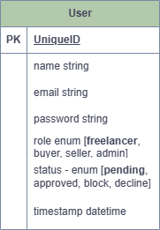
User Model

Slide 17
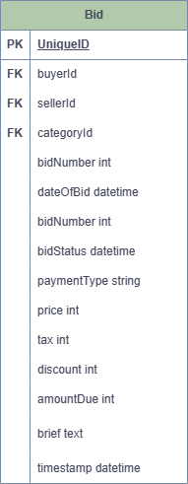
Profile Model

Slide 18
Bid Model

Slide 19
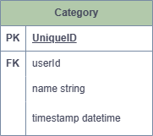
Category Model

Slide 20
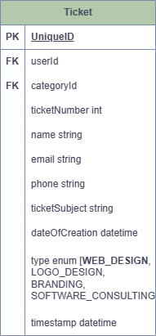
Ticket Model

